Slide 1
Text classification

Slide 2

Text classification process

Slide 3
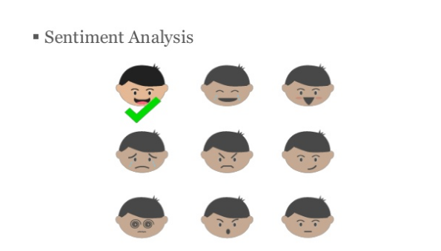

Slide 4

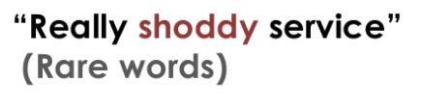
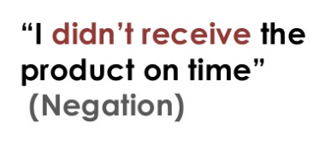
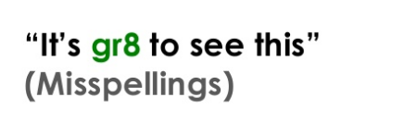
What’s hard?

Slide 5
Word embeddings

Slide 6
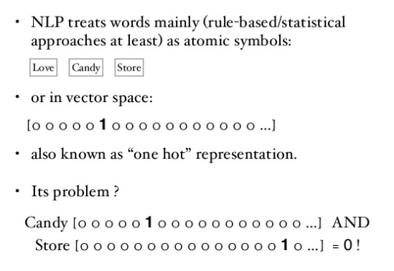
Word representation

Slide 7
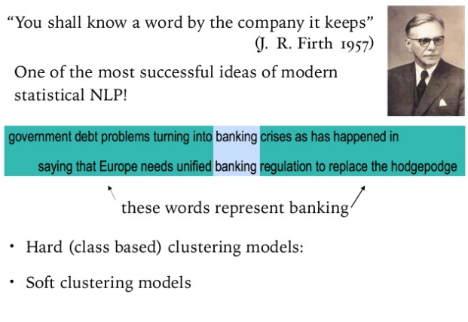
Distributional representation

Slide 8
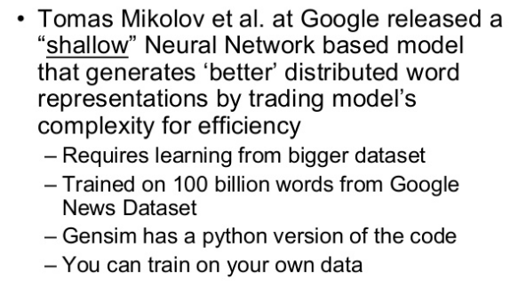
Start

Slide 9
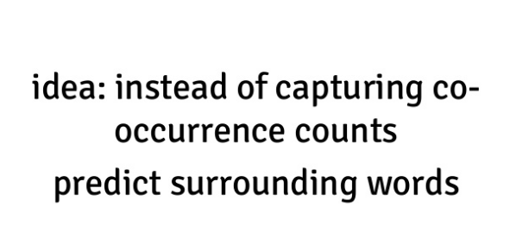
WORD2VEC

Slide 10
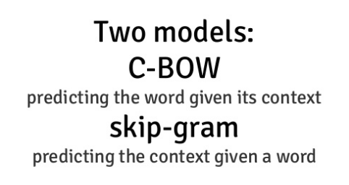
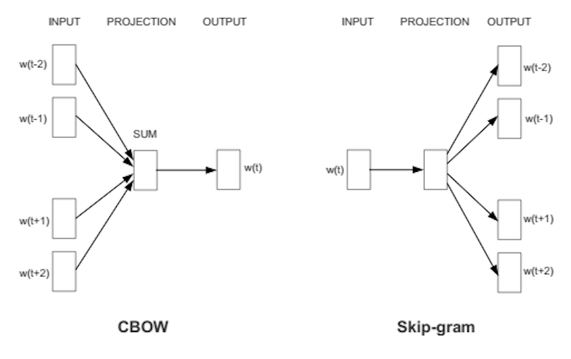
Word2Vec

Slide 11
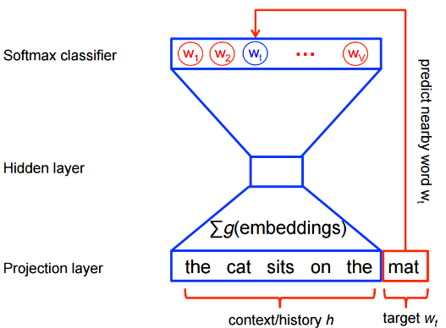
Neural Network inside

Slide 12
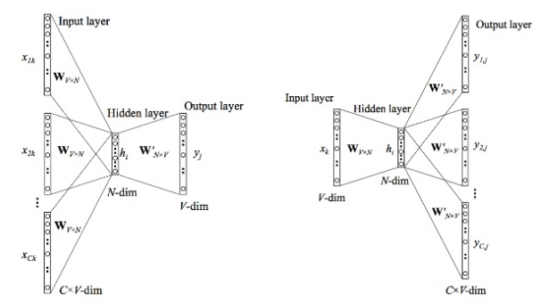
Neural Netwroks for both methods

Slide 13
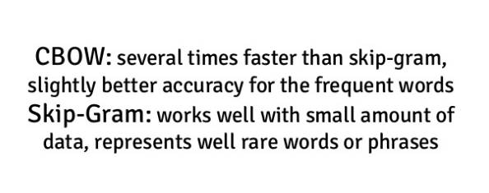
What use?

Slide 14
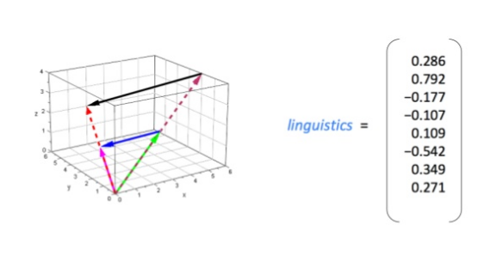
Result

Slide 15
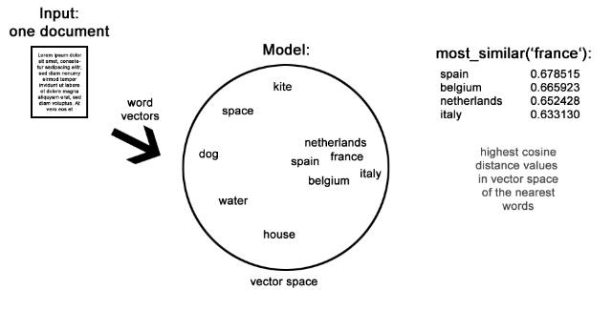
Process

Slide 16
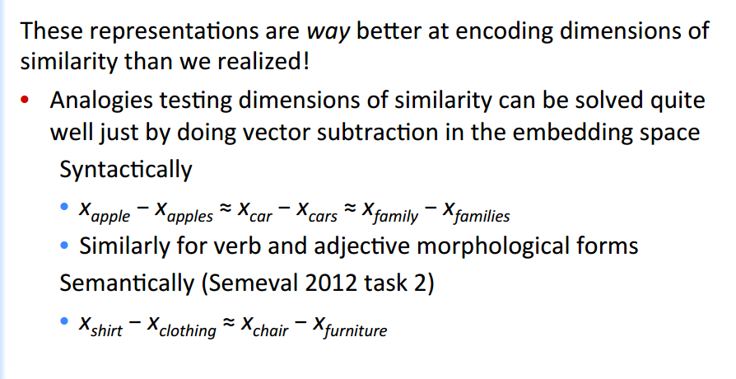
Text classification process: Supervised ML

Slide 17
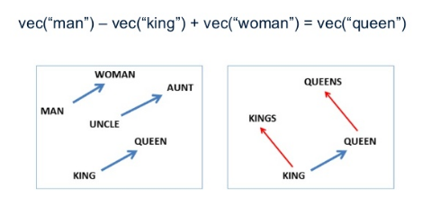
Example

Slide 18
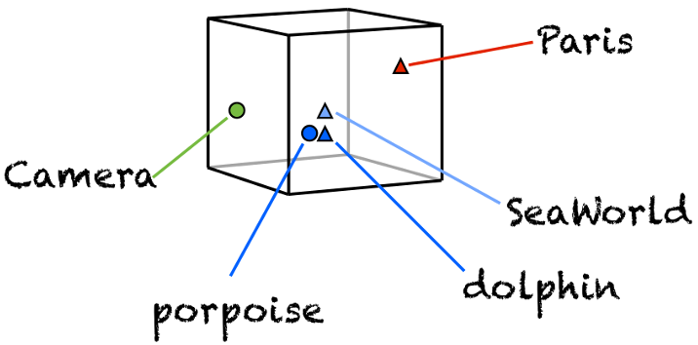
Example

Slide 19
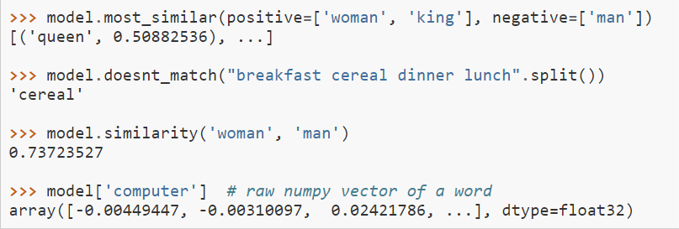
Example

Slide 20
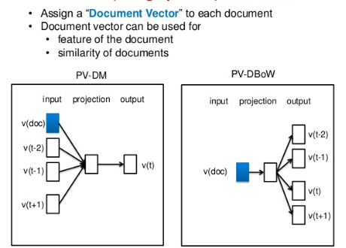
DOC2VEC

Slide 21
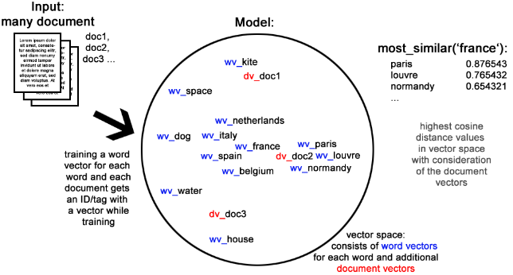
Process

Slide 22
LSA / LDA

Slide 23
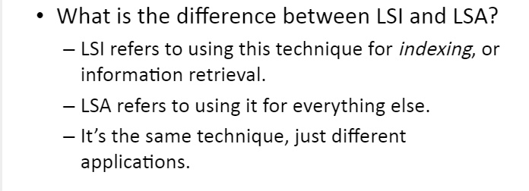
LSI&LSA

Slide 24
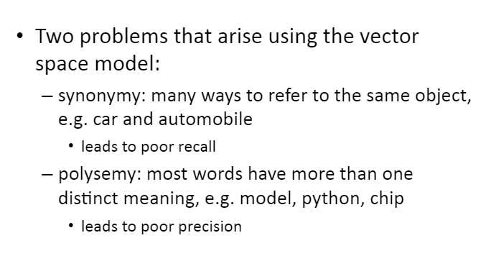
The Problem

Slide 25
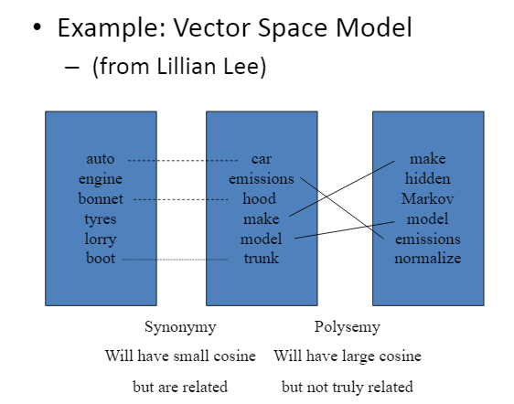
The Problem

Slide 26
LSA: What is it?
statistical method for automatic indexing and retrieval that attempts to solve the major problems of the current technology
Intended to uncover latent semantic structure in the data that is hidden
Creates a semantic space wherein terms and documents that are associated are placed near one another

Slide 27
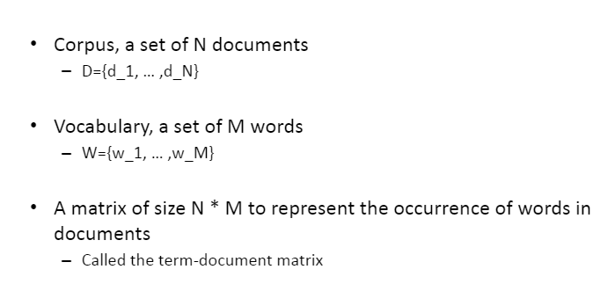
The Setting

Slide 28
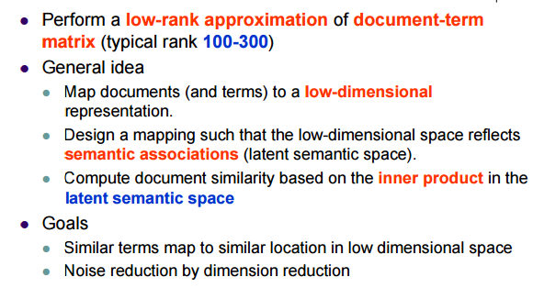
Latent Semantic Analysis

Slide 29
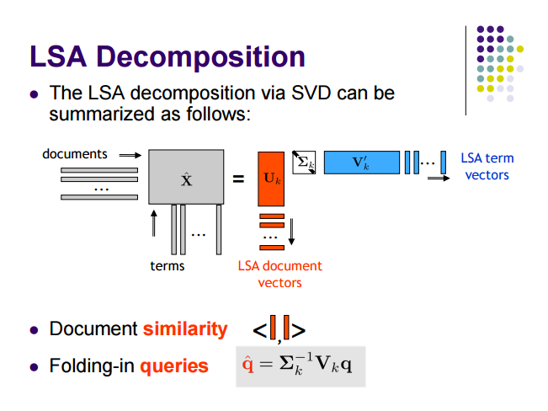

Slide 30
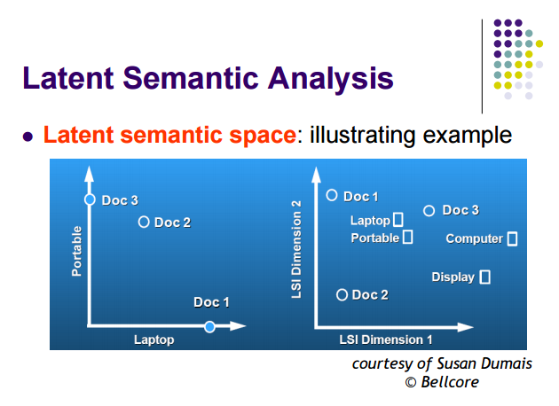
Example

Slide 31
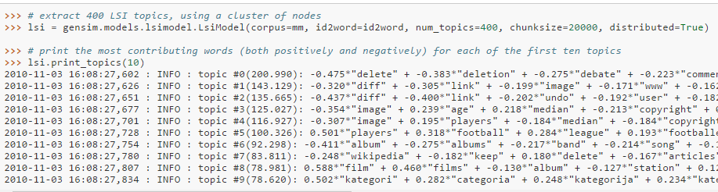
The Result

Slide 32
LDA
Latent Dirichlet allocation (LDA) is a topic model that generates topics based on word frequency from a set of documents. LDA is particularly useful for finding reasonably accurate mixtures of topics within a given document set.

Slide 33
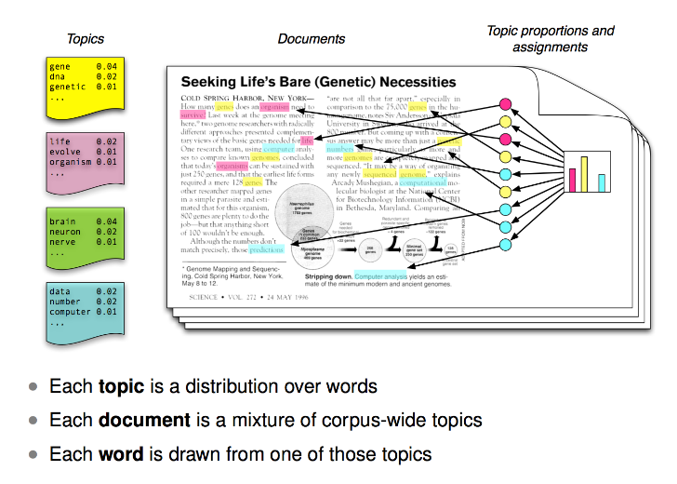
LDA process

Slide 34
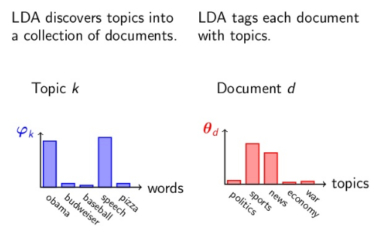
LDA process

Slide 35
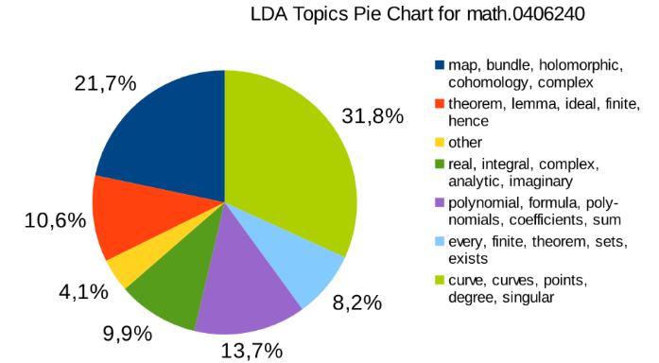
Example

Slide 36
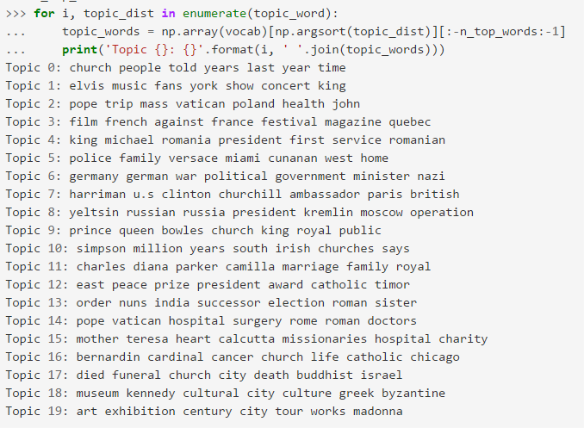
LDA process

Slide 37
Thank you!

